Slide 2
This Week’s Sermons
Monday: What About the Thief on the Cross?
Tuesday: When Temptation Comes
Wednesday: Mediocrity
Thursday: Instrumental Music in Worship
Friday: Heaven is Better

Slide 3
Mediocrity

Slide 4
Philippians 1:9-10
And this I pray, that your love may abound still more and more in knowledge and all discernment,
that you may approve the things that are excellent, that you may be sincere and without offense till the day of Christ,

Slide 5
What is Mediocrity?
Mediocre - from an old Latin word mediocris
medius (middle) + ocris (rugged mountain)
Thus, mediocre can literally mean “halfway up the mountain.”
“of a middle quality, indifferent, ordinary, commonplace”
“neither very good nor very bad, ordinary, average”
“not good enough, inferior”

Slide 6
The Mediocre Life
It is easy to see the appeal of the mediocre life.
It takes less effort to reach sub-par standards, so if we accept that which is less than the best we don’t have to put forth much effort.
It appeals to those who want instant gratification instead of doing the hard work and achieving real success.

Slide 7
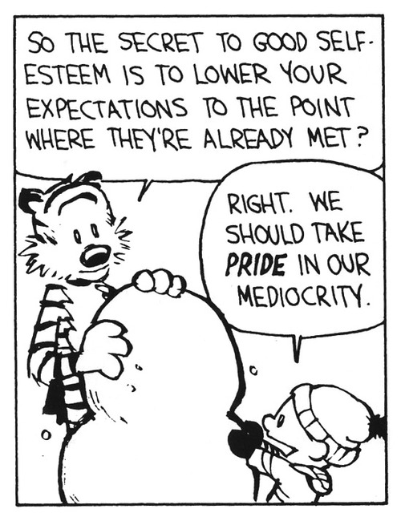
The Mediocre Life

Slide 8
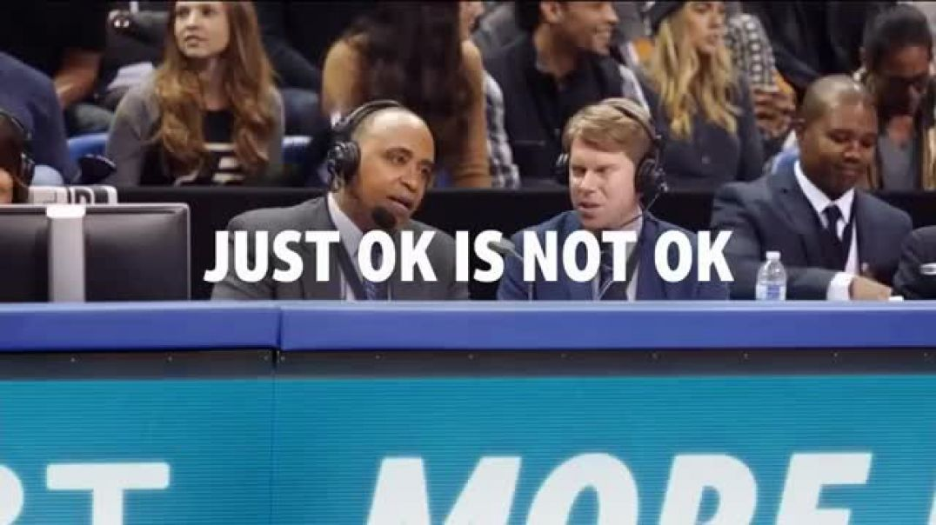

Slide 9
Dangers of the Mediocre Life
Renders us unfruitful and unproductive - Col. 1:9-10
Leads to laziness - Prov. 6:6-11
Leads to impulsiveness and impatience - Heb. 6:9-12
Justify ourselves by using the wrong comparisons - 2 Cor. 10:12
The Lord will not accept such standards - Malachi 1:8
Such an attitude sickens the Lord - Rev. 3:15-16

Slide 10
The Excellent Life
Excel - to rise, surpass, or project out of or from something.
“to be better or greater than; to be superior to another or others”

Slide 11
Our God is an Excellent God
He is excellence - Psalm 8:1, 9
His works are excellent - Gen. 1:31; Ps. 150:2; Is. 12:4-5
He promises excellence - 2 Pet. 1:2-4
He invites us to excellence - John 10:10; Phil. 3:13-14

Slide 12
God Desires Excellence in Our…
Faith - Matthew 17:20
Love - Matthew 5:43-48
Service - Matthew 25:21; Romans 12:1
Relationships - Colossians 3:18-21
Giving - 2 Corinthians 8:3-5
Living - Ephesians 4:1

Slide 13
Overcoming Mediocrity
Learn to appreciate excellence in everything Hebrews 8:6
Imitate the excellence of others Hebrews 6:12; 12:1-2
Encourage excellence in others Hebrews 10:24

