Slide 2
Both must learn to Care and Protect each other in practical ways!

Slide 3
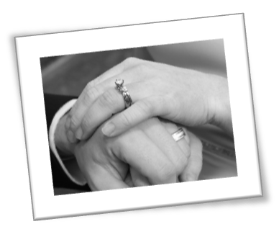


Check out on your website:
Key Concepts that Make a Marriage Work

Slide 4
Three Part Series:
Part One: Bible class
  Introduction
Part Two: Worship
  Overcoming Love Busters.
Part Three: Sunday p.m.
  Meeting each others’ needs.

Slide 5
Thesis: Part One
The Love Bank – key to passion!
The Romantic Myth - dangerous
Importance of Habits – crucial!
Introduce Love Busters…

Slide 6
True Love
I Cor. 13:4-8
How do I keep it alive?
Love is patient and kind; love does not envy or boast; it is not arrogant or rude. It does not insist on its own way; it is not irritable or resentful; it does not rejoice at wrongdoing but rejoices with the truth. Love bears all things, believes all things, hopes all things, endures all things. Love never fails.

Slide 7


Slide 8
Love Busters
Define: “A destructive marital habit which is a repeated behavior of a spouse that causes the other to be unhappy (withdraw love units!)”

Slide 9
Love Busters
ANGRY OUTBURSTS!
  Used as a way to punish or get back at the other party.
  Dangerous: Harshness creates disrespect.

Slide 10
Love Busters
ANGRY OUTBURSTS!
  Job’s wife: “Curse God and die” (Job 2:9)!

Slide 11
Angry Outbursts
“Be swift to hear, slow to wrath” (Jas 1:19-20).
“He who is quick-tempered acts foolishly” (Prov 14:17).
“There is one who speaks like the piercing of a sword” (Prov 12:18).

Slide 12
Disrespectful Judgments
  No one likes a caustic critic!
  Impose your values.
  Viewed as rude, arrogant,& disrespectful.
  Jas 4:11-12 “Who are you to judge?”

Slide 13


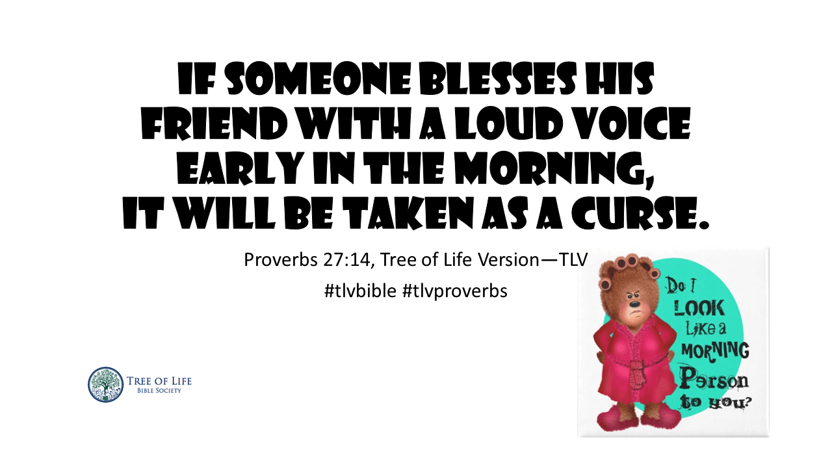
Annoying Behaviors
Prov 27:14

Slide 14
Annoying Behaviors
  Doing something that irritates the other party consistently.
  Women tend to find men more annoying than men find women!
  Make a commitment to be considerate.

Slide 15
Selfish Demands
  “Demands choke out love.”
  You can have a slave or a lover, but you can’t have both!
  Threats, lectures, and mani-pulation which builds resentment and causes the other party discomfort.

Slide 16
Selfish Demands
  Delilah pressuring Samson daily until his soul was vexed (Judges 16:15-16).

Slide 17
Selfish Demands
“Let nothing be done through selfish ambition. Let each of you look out not only for your own interests, but also for the interests of others.” (Phil 2:3-4).
Ask how the other party would feel before moving forward.

Slide 18
Dishonesty
Serious: Breaks down TRUST
Who wants to live with a liar?
KEY: Reveal to your spouse your thoughts, feelings, habits, likes, dislikes, personal history, daily activities, and plans for the future.

Slide 19
Dishonesty
Jacob deceived Isaac (Genesis 27:1-13).

Slide 20
Dishonesty
“Therefore, putting away lying, each one speak truth” Eph 5:25
“Do not lie to one another ..” Col 3: 9-10, Rev 21:8.
“Lying is an abomination to Jehovah but those who deal truthfully are His delight” (Prov 12:22).

Slide 21
Independent Behavior
Def: “The conduct of one spouse that is conceived and executed as if the other spouse did not even exist.”
Not talking about unhealthy dependency.
Key: Interdependent behavior where the partners nurture and protect each other!

Slide 22
Independent Behavior
The opposite of a “cooperative partnership” (Gen 2:24, Eph 5:31).
“So they are no longer two, but one. Therefore what God has joined together, let man not separate“ (Mark 10:8-9). NIV

Slide 23

Love Busters
Angry Outbursts
Disrespectful Judgments
Annoying Behaviors
Selfish Demands
Dishonesty
Independent Behavior

Slide 24
Love Busters
Romantic love is the victim!
Love deposits will not be received.
Be careful. A few major withdrawals can undo scores of prior deposits!

Slide 25

SIX TIPS TO OVERCOME
Be committed and yet have patience. Takes time!
Do one at a time. . .
Identify the why.
Avoid “triggers.”

Slide 26
Six Tips to Overcome
Develop alternative behaviors. Righteous substitute.
As your mate for evaluation weekly. Don’t give up!
Pray both privately and together.

Slide 27

What is the KEY?
Both must communicate clearly without being defensive!
Use the “Rate Your Mate’s” forms
Each spouse must really listen and develop new habits!

Slide 28
Both must learn to care and protect each other in practical ways!

