Slide 1
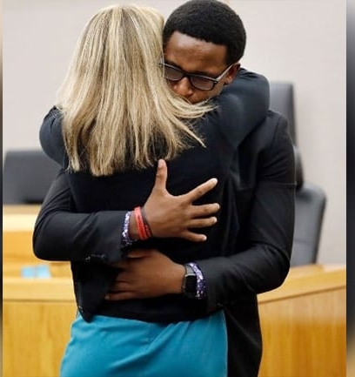
The accidental murder of Botham Jean 9/6/2018
Amber Guyger

Slide 2
The Awesome Power of Forgiveness!

Slide 3
Questions about Forgiveness?
Do I have to “forgive” someone before they even ask or repent?
Is forgiveness equivalent to forgetting?

Slide 4
"For thou, Lord, art good
and ready to forgive."
Ps 86:5

Slide 5
1 John 2:1-2 “And if anyone sins, we have an Advocate with the Father, Jesus Christ the righteous; and He Himself is the propitiation for our sins.”
Vertical

Slide 7
Thesis:
Divine promises/standard
Definitions
Implications
Biblical admonitions

Slide 8
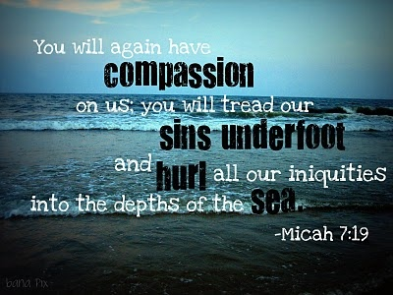
Divine Promises:

Slide 9
Divine Promises:
“I have removed your
transgressions from you.”

Slide 10
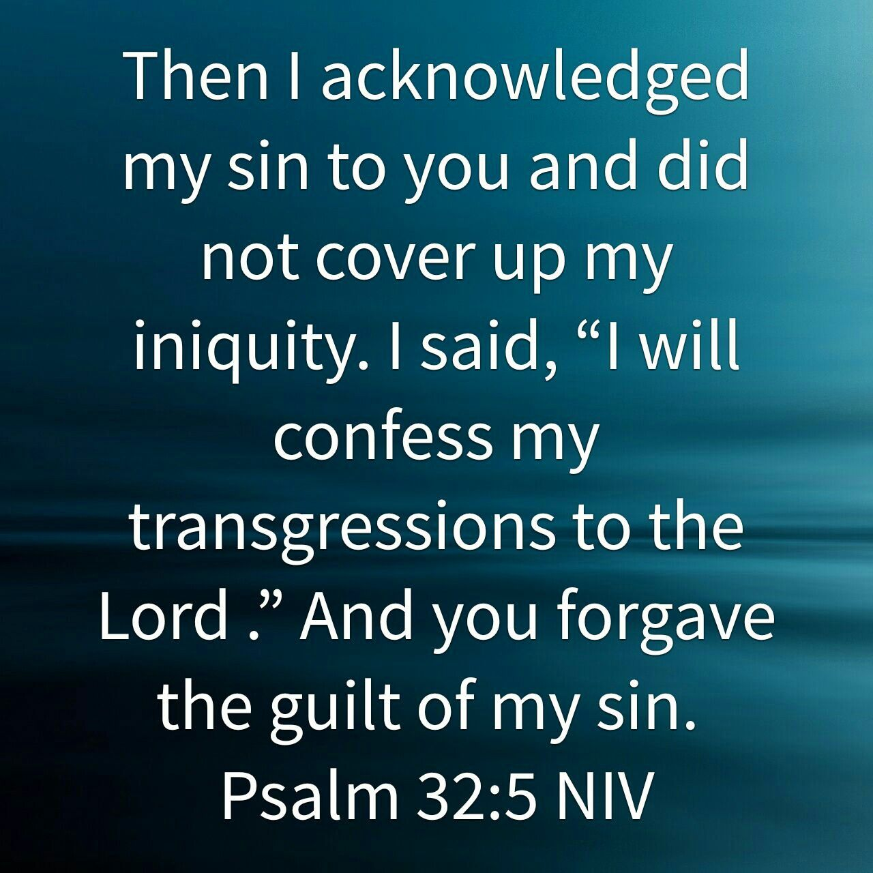
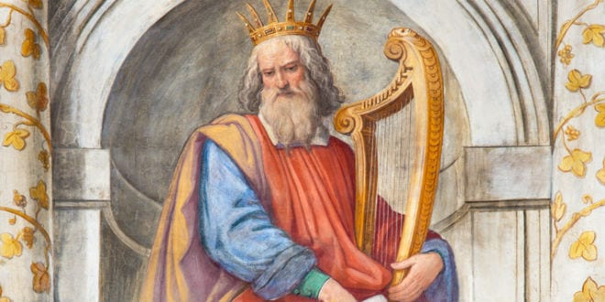
King David

Slide 11
Has Horizontal implications!

Slide 12
Greek word = “aphiemi”
Means to remit a debt and is used metaphorically (Matt 6:12).
Def: “An attitude of heart which restores the offender to the former state and affections of the offended one.”
2nd Def: “To cease to feel resentment against, or to seek payback.”

Slide 13
Forgiveness of Others!
“Forgive one another, even as Christ forgave you, so also do you” (Col 3:13).
“Be kind to one another, tender hearted, forgiving one another, even as God for Christ’s sake hath forgiven you” (Eph 4:32).

Slide 14
Forgiveness is not Optional!
We must forgive others!
“If your brother sins, rebuke him; and if he repents, forgive him (Lk 17:3).
Forgiveness is conditional on repentance (I Jn 1:9, Acts 2:38)!

Slide 15
Forgiveness of Others!

Slide 16
Put Yourself to the Test
Is the relationship the same as before the offense?
Do you feel as kindly towards them now as before?
Trust and Forgiveness are different!

Slide 17
I’ll Forgive, but Never Forget!
Usually said with bitterness & animosity.
“From your hearts you must forgive your brother his trespasses” (Mt 18:35).

Slide 18
Parable of the Prodigal Son

Slide 19
How Can I Forgive and Forget?
Heb 8:12 “I will remember your sins no more.”
Not “erasing from memory.”
“Blots out our sins” (Acts 3:19).

Slide 20
Am I Expected to Forget?
Isaiah 43:18 “Remember not the former things.”
Not memory loss!
Isaiah 43:25ff God does “not remember” their sins after listing them!
NASV – “Do not call to mind.

Slide 21
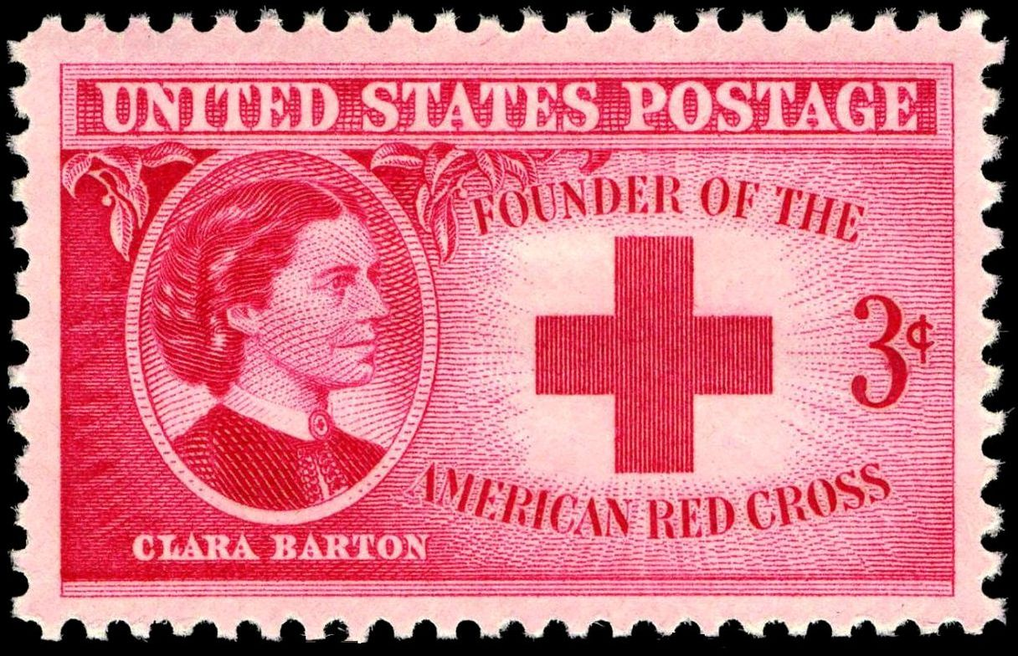
What does “remember no more” mean?
One can completely forgive and still remember the sin.
Clara Barton: “I distinctly remember forgetting that.”

Slide 22
Implications for Human Relationships
God is ready and willing to restore the relationship, if possible.
We also must hold no malice.
Stephen – Acts 7: 60 “Lord, lay not this sin to their charge.”
We must pray for those who seek our harm (Mt 5:44, Rm 12:19-21).
We sin in failing to pray for offenders (I Sam 12:23).

Slide 23
Implications/Principles
Forgiveness is to be unlimited (Matt 18:21-22).
"Lord, how often shall my brother sin against me and I forgive him? Up to seven times?“
Jesus said to him, "I do not say to you, up to seven times, but up to seventy times seven.

Slide 24
Forgiveness is not optional!
“If you forgive not men their trespasses, neither will your Father forgive your trespasses” (Matt 6:15).

Slide 25
Implications/Principles
Our sins against one another are small (Matt 18:23-35).
Forgiveness is “too big” for “little people.”

Slide 26
Implications/Principles
We will receive mercy based upon how merciful we are (Mt 7:1-2)!
"For in the way you judge, you will be judged; and by your standard of measure, it will be measured to you.”
Matt 5:7 "Blessed are the merciful, for they shall receive mercy.”

Slide 27
Implications of the Principle
Golden Rule applies. Mt 7:12
Ever have someone refuse to forgive you?
How did it feel?
“Imagine a world of no forgiveness, mercy, and grace and you have a postmodern cancel culture world. Instead, Jesus came to cancel our debt (Col.2:14), not people.”

Slide 28
The accidental murder of Botham Jean 9/6/2018
Amber Guyger

