Slide 1
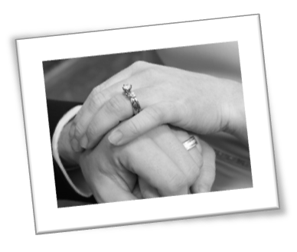
Gen 2:15-24
Adam was lonely (Gen 2:18).
Eve was the answer –
“Helper suitable” (Gen 2:20)!
Key to a mutually satisfactory love relationship.

Slide 2
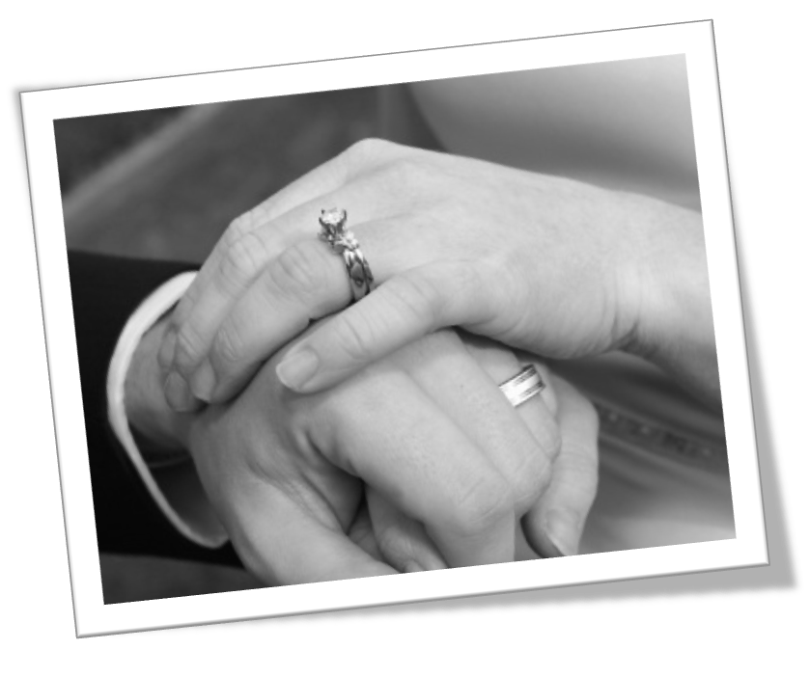

Slide 3
Two Sides to Marital Conflict
Couples fail to make each other happy
(Failure to care… make deposits!)
Couples make each other unhappy
(Failure to protect …make withdrawals!)

Slide 5
Two Keys to Meeting Needs:
The Golden Rule (Matt 7:14).
Mutual humility and submission (Eph 5:21).

Slide 6
10 Marital Needs (After Spiritual Needs are met)
Affection
Conversation
Financial Support
Family Commitment
Honesty and Openness
Admiration (Respect)
Sexual Fulfillment
Attractiveness of Spouse
Recreational Companionship
Domestic Support
Man
Woman

Slide 7
Five Typical Needs of a Woman
AFFECTION:
Both are to “be tenderly affectionate one to another; in honor preferring one another” (Rm 12:10, Phil 2: 3-5).
Important to make a distinction between affection and sex.

Slide 8
Five Typical Needs of a Woman
CONVERSATION (Eph 4:29)
Women are more verbal!
“Communication and relational development are symbiotic.”
Key: Undivided attention!
“Quick to (listen)..” Jas 1:19

Slide 9
Five Typical Needs of a Woman
FINANCIAL SUPPORT:
Women want security!
Man = “bread winner”
Gen 3:19 Man: “Sweat of his face.”
I Tim 5:8 “If a man does not provide, worse than an infidel!”

Slide 10
Five Typical Needs of a Woman
FAMILY COMMITMENT:
Husband – “House band” (I Tim 3:5)!
Woman wants a good father and husband, not just a good provider (Eph 6:4).

Slide 11
Five Typical Needs of a Woman
HONESTY AND OPENNESS
Eph 4:15 “Speak the truth in love.”
Rev 14:4-5 “These are the ones who follow the Lamb . . no lie was found in their mouth.”

Slide 12
Five Typical Needs of a Man
ADMIRATION (RESPECT) #1!
“If a wife is able to look at her husband with eyes full of admiration, he becomes a king among men.”

Slide 13
Five Typical Needs of a Man
ADMIRATION (RESPECT) #1!
“A man needs to be respected while a woman needs to cherished.”
“Let the wife see that she reverence her husband” (Eph 5:33).

Slide 14
Five Typical Needs of a Man
SEXUAL COMMITMENT:
“God gave woman the greater physical beauty; man the greater physical desire” (Ecc 9:9; Prov 5:18-19).
“56% of men think about sex daily, only 16% of women do!” Time
I Cor 7:5 “Do not defraud . . ..”

Slide 15
Five Typical Needs of a Man
PHYSICAL ATTRACTIVENESS:
Def: “Keeping fit with diet and exercise; wearing hair and clothes in a way the spouse finds attractive.”
Men are visually oriented (Judges 14: 1-3).

Slide 16
Five Typical Needs of a Man
PHYSICAL ATTRACTIVENESS:
Greater emphasis on “inner beauty” (I Peter 3:3-5).
Looking the best for our mate is one way to honor them!

Slide 17
Five Typical Needs of a Man
RECREATIONAL COMPANION:
“Family that plays together stays together.”
Ecc 3:1 “For everything there is a season.” vs 11 “beautiful in its time.”
Fun = deposits!

Slide 18
Five Typical Needs of a Man
DOMESTIC SUPPORT
Def: “Creating a home environment that offers a refuge; managing home and children so the spouse enjoys being with the family.”

Slide 19
Five Typical Needs of a Man
DOMESTIC SUPPORT
“Ruler of the household” (I Tim 5:14).
“Love their husbands, workers at home” (Titus 2:4-5).

Slide 20
Marriage is about meeting needs!
ARE YOU MEETING YOUR SPOUSE’S NEEDS?
Become an expert!

Slide 21
Use the Two-Page Handout
Stay and grow in your love by meeting needs.
Learn which ones are the most important (Top 5).
Rate your top ten needs and communicate!
You and your spouse’s priorities will differ.
Understanding this helps you to work smart and avoid frustration!

Slide 22
Remember:
As you meet your spouse’s needs, your spouse will be more compelled to meet yours.
You will receive great satisfaction in mutually making deposits!
Over time your love for him/her will grow!

Slide 24
Marriage= Christ and the Church
Object: NOT
COMFORTABLE FOR ME!
Was the cross comfortable for Christ?
Rm 5:8
John 3:16

