Slide 1
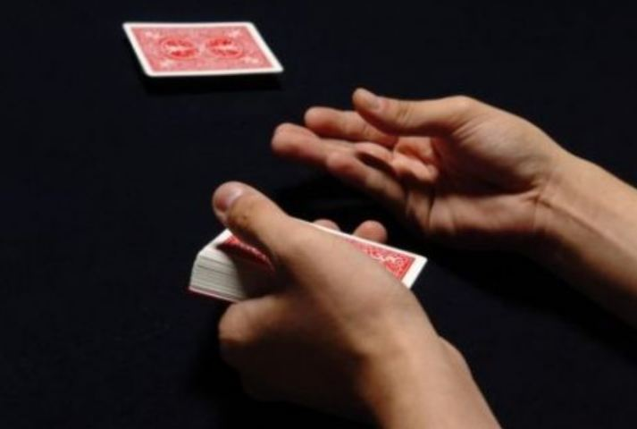
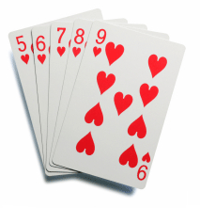
Winning With The Hand You Are Dealt
Brent Hunter
Saturday
Lesson Two
September 11, 2021

Slide 2
The Five Cards We are Dealt:
1. Chemistry
2. Connections
3. Circumstances
4. Consciousness
5. Choices
Winning with the Hand you are Dealt!

Slide 4
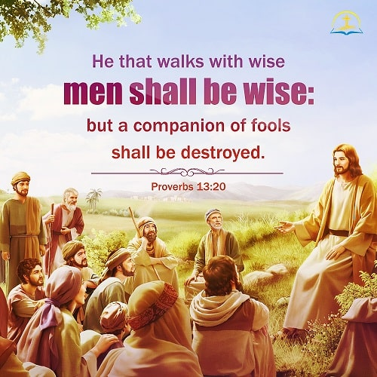

Slide 8
Five winning choices:
1.
2.
3.
4.
5.
Winning with the Hand you are dealt!

Slide 9
Five winning choices:
1. I can choose to get healthier
2.
3.
4.
5.
Winning with the Hand you are dealt!

Slide 10
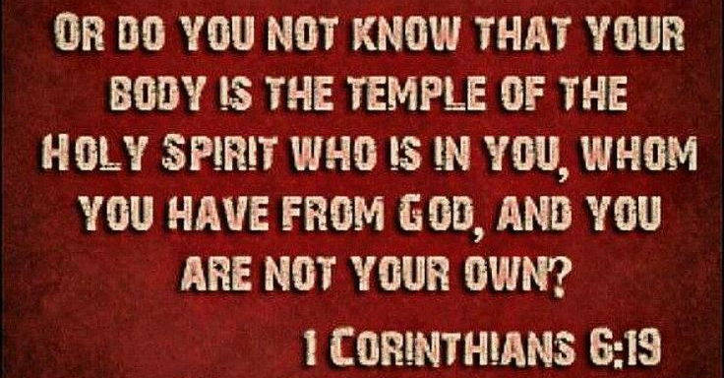

Slide 11
Psalm 119:73
NASU
Your hands made me and fashioned me;
give me understanding, that I may learn your commandments.
Now give me sense to heed your laws.
Winning with the Hand you are dealt!

Slide 12
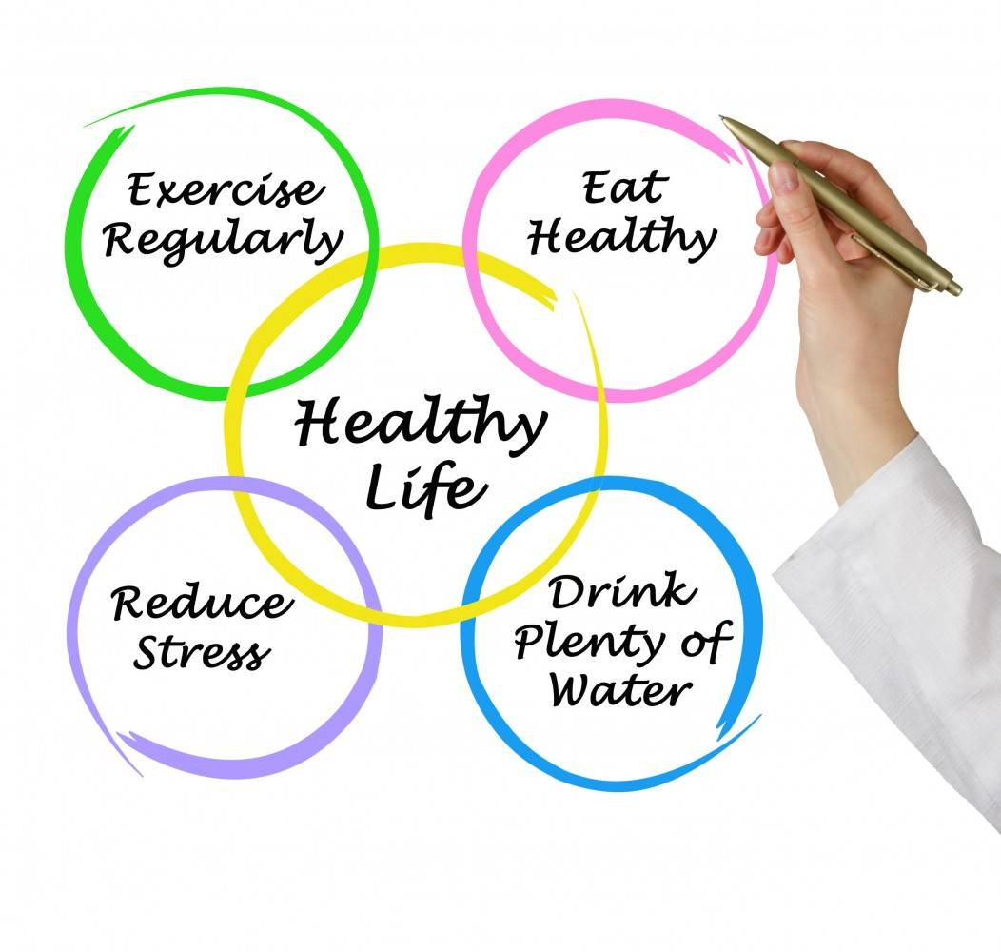

Slide 13
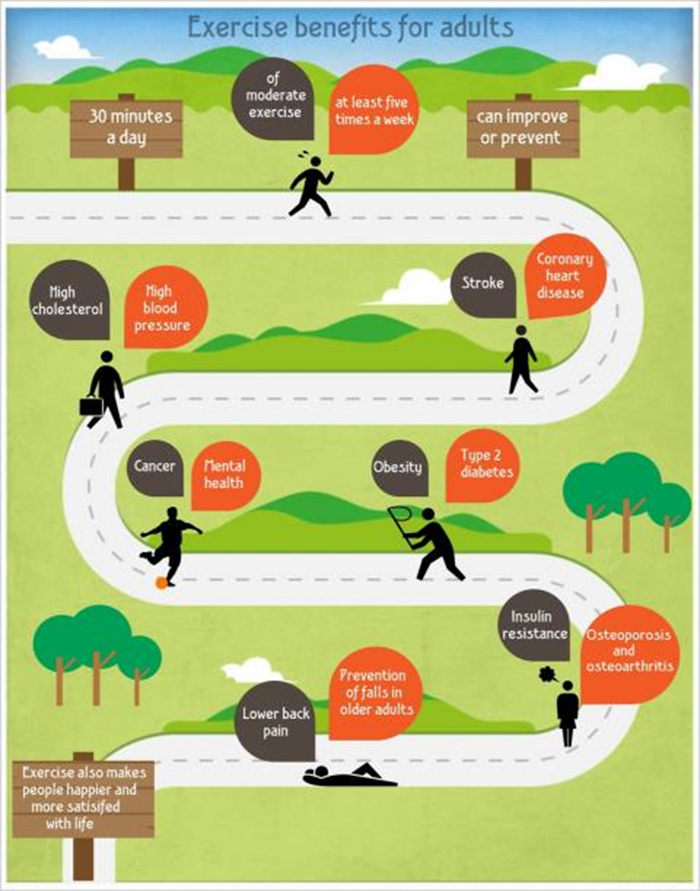
*Enhances sense of accomplishment/self-esteem
*Improves sleep
*Increases flexibility
*Builds collateral circulation
*Helps manage stress
*Helps improve strength, stamina, energy, functionality
….the list goes on

Slide 14
Five winning choices:
1. I can choose to get healthier
2. I can choose to deepen my relationships
3.
4.
5.
Winning with the Hand you are dealt!

Slide 15
is what prevents
connection.
Awkward won’t kill me!

Slide 16
1 John 4:18
New International Version
Winning with the Hand you are dealt!

Slide 17
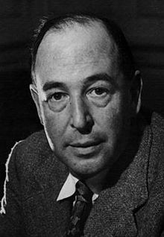

Slide 18
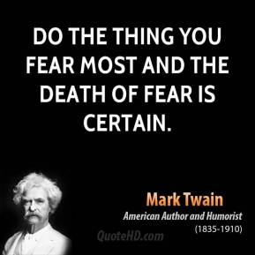
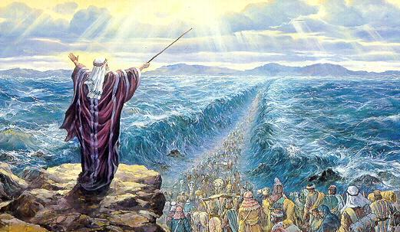

Slide 19
Winning with the Hand you are dealt!

Slide 20
Ephesians 3:17
Winning with the Hand you are dealt!

Slide 21
Five winning choices:
1. I can choose to get healthier
2. I can choose to deepen my relationships
3. I can choose to trust God
4.
5.
Winning with the Hand you are dealt!

Slide 22
Winning with the Hand you are dealt!

Slide 23
I will praise the Lord no matter what happens!
Romans
8:28
Winning with the Hand you are dealt!

Slide 24
I’m a product of my past,
but I’m not a prisoner of it.

Slide 25
Five winning choices:
1. I can choose to get healthier
2. I can choose to deepen my relationships
3. I can choose to trust God
4. I can choose what I think about
5.
Winning with the Hand you are dealt!

Slide 26
Winning with the Hand you are dealt!

Slide 28
Winning with the Hand you are dealt!

Slide 29
Five winning choices:
1. I can choose to get healthier
2. I can choose to deepen my relationships
3. I can choose to trust God
4. I can choose what I think about
5. I can choose Jesus as my Savior
Winning with the Hand you are dealt!

Slide 30
Let Jesus be your
Savior every day!
Winning with the Hand you are dealt!

Slide 31
You Will Win With The Hand You’ve Been Dealt!

