Slide 1
Brick By Brick
Commitment

Slide 2
C U L T U R E
O
L
L
E
C
T I V E L Y
P
L I F T I N G
I V E S
H R O U G H
T I L I Z I N G
E S O U R C E S
V E R Y D A Y

Slide 3
9 cling to what is good.
(Romans 12:9c)

Slide 4
What are we Committed to?

Slide 5
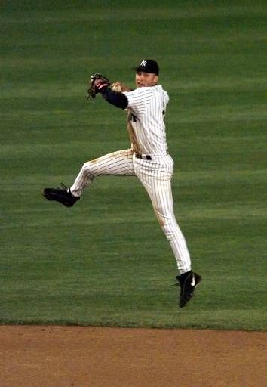
Notes:
October 06, 1998… Jeter’s signature play was his jump throw deep in the hole at shortstop. One of his most memorable came in the 1998 ALCS against the Indians, when he fired a bullet to nab Travis Fryman at first.

Slide 6
1.) Be Committed to God
Commitment

Slide 7
God is 100% Committed to Us
16 For God so loved the world that he gave his one and only Son (for us), that whoever believes in him shall not perish but have eternal life.
(John 3:16)

Slide 8
We are to be 100% Committed to God
30 Love the Lord your God with all your heart and with all your soul and with all your mind and with all your strength.’
(Mark 12:30)

Slide 9
This commitment should ALWAYS be first
33 But seek first his kingdom and his righteousness, and all these things will be given to you as well.
(Matthew 6:33)

Slide 10
Real commitment does not have an on and off switch.
If we are really committed to God, people will notice.
Notes:
Real commitment is not a Sunday thing, its 24 hours a day, 7 days a week, 365 days a year, with no vacations or off days. You are the same person on Monday through Saturday as you are on Sunday.

Slide 11
2.) Be Committed To Family
Commitment

Slide 12
Husbands should have no problem loving their wife.
25 Husbands, love your wives, just as Christ loved the church and gave himself up for her
(Ephesians 5:25)
Notes:
When was the last time you did something for that special someone in your life for no reason at all? Marriage is not about what I want… it’s about what’s best for my partner.

Slide 13
Wives should have no problem submitting to their loving husband.
22 Wives, submit yourselves to your own husbands as you do to the Lord.
(Ephesians 5:22)
Notes:
When was the last time you did something for that special someone in your life for no reason at all? Marriage is not about what I want… it’s about what’s best for my partner.

Slide 14
Children should love and honor parents who love them and teach them
according to the Bible.
16 “Honor your father and your mother, as the Lord your God has commanded you, so that you may live long and that it may go well with you in the land the Lord your God is giving you.
(Deuteronomy 5:16)
Notes:
When was the last time you did something for that special someone in your life for no reason at all? Marriage is not about what I want… it’s about what’s best for my partner.

Slide 15
F A M I L Y
O R G E T
B O U T
E
O V E
O U

Slide 16
3.) Be Committed to Church
Commitment

Slide 17
Would you be “fired” as a Christian based off your attendance?
25 not giving up meeting together, as some are in the habit of doing, but encouraging one another—and all the more as you see the Day approaching.
(Hebrews 10:25)
Notes:
Not giving up… “privilege”

Slide 18
“Do we have to go to church today?"
Notes:
“Sundayitus epidemic: (a) 1 sneeze and back to bed you go, but On Monday grab a hanky and go to work. Just to tired on Sunday night. When you get to busy to go to church you are too busy. Wednesday night too many things to do. God can take some things away, so you won’t have an excuse.”

Slide 19
Commitment to Church Growth?
Commitment to Church Needs?
Notes:
How many people did you talk to this week? How many did you talk to about Christ? How many friends did you invite this week? Didn’t have the Time - Not committed to Church growth! 86,400 seconds in a day.

Slide 20
Are we robbing God?
8 “Will a mere mortal rob God? Yet you rob me.
“But you ask, ‘How are we robbing you?’
(Malachi 3:8)

Slide 21
“In tithes and offerings. 9 You are under a curse—your whole nation—because you are robbing me. 10 Bring the whole tithe into the storehouse, that there may be food in my house. Test me in this,” says the Lord Almighty, “and see if I will not throw open the floodgates of heaven and pour out so much blessing that there will not be room enough to store it.
(Malachi 3:8b-10)

Slide 22
7 Each of you should give what you have decided in your heart to give, not reluctantly or under compulsion, for God loves a cheerful giver.
(2 Corinthians 9:7)

Slide 23
“Give Me your BEST!!!”
Notes:
We need to be committed, to giving to the church. It’s more than giving, it’s supporting the Church, with our love, our prayers, our time, our availability, and our finances! The heating, A/C or lights don’t just happen by themselves. This audience is Committed & We need to STAY committed.

