Slide 1
Brick By Brick
Humility

Slide 2
C U L T U R E
O
L
L
E
C
T I V E L Y
P
L I F T I N G
I V E S
H R O U G H
T I L I Z I N G
E S O U R C E S
V E R Y D A Y

Slide 3
\
16 Do not be proud…
(Romans 12:16b)

Slide 4
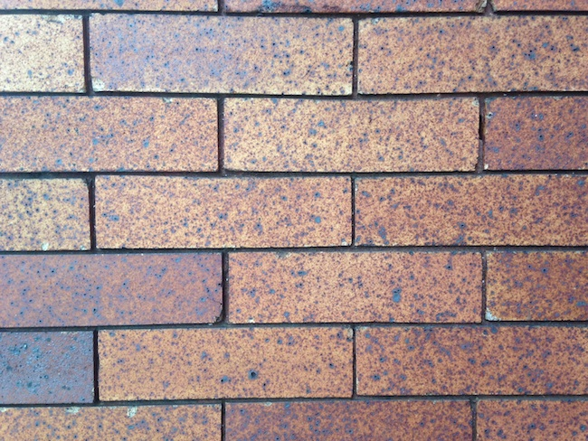
1.) Wearing Pride Leads to Anxiety
Humility

Slide 5
\
Would you rather be opposed or favored?
5 In the same way, you who are younger, submit yourselves to your elders. All of you, clothe yourselves with humility toward one another, because,
“God opposes the proud
but shows favor to the humble.”
(1 Peter 5:5)
Notes:
Pride is not a characteristic of a Christian. The world does not revolve around us!!!

Slide 6
\
It’s okay to ask for help!
6 Humble yourselves, therefore, under God’s mighty hand, that he may lift you up in due time. 7 Cast all your anxiety on him because he cares for you.
(1 Peter 5:6-7)
Notes:
Sometimes there are things that we can’t do. We don’t like asking for help.

Slide 7
\
Would you rather be wise or a disgrace?
2 When pride comes, then comes disgrace, but with humility comes wisdom.
(Proverbs 11:2)
Notes:
Sometimes there are things that we can’t do. We don’t like asking for help.

Slide 8
It’s hard to fight anxiety, but you can fight pride.
If you rid yourself of pride, you will help with your anxiety.

Slide 9
2.) Wearing Pride Leads To Sin
Humility

Slide 10
Ar
Are you making things hard or easy for Satan?
8 Be alert and of sober mind. Your enemy the devil prowls around like a roaring lion looking for someone to devour.
(1 Peter 5:8)

Slide 11
Satan works a lot like Netflix…he learns what you like and puts more of it in front of you.

Slide 12
EGO

Slide 13
When you feed something, it grows.
When you starve something, it dies

Slide 14
As God gets bigger in our lives, our struggles will get smaller.
30 He must become greater; I must become less.
(John 3:30)

Slide 15
Your struggles are not unique.
13 No temptation has overtaken you except what is common to mankind. And God is faithful; he will not let you be tempted beyond what you can bear. But when you are tempted, he will also provide a way out so that you can endure it.
(1 Corinthians 10:13)

Slide 16
3.) Wearing Humility Is Always Important
Humility

Slide 17
Humility looks good on everyone!
9 Resist him, standing firm in the faith, because you know that the family of believers throughout the world is undergoing the same kind of sufferings.
(1 Peter 5:9)

Slide 18
Everywhere we go has a dress code. Humility is the dress code of God’s Kingdom.
10 And the God of all grace, who called you to his eternal glory in Christ, after you have suffered a little while, will himself restore you and make you strong, firm and steadfast.
(1 Peter 5:10)
Notes:
Humility isn’t just attractive, it’s powerful. We receive God’s favor, are protected by the hand of God, can trust His timing, are not anxious, know the love of God, can resist the devil, have a right view of sin, have eternal glory, have restored resolve, know where the power lies

